Slide 1





OKANAGAN FALLS ELEMENTARY SCHOOL
SCHOOL PLAN
Enhancing Education and Student Success Through Writing; A multi-year plan.
2025/2026

Slide 2



Scanning
We used the following for our scanning this year and last year as well:
  FSAs
  Whole school year end data
  MDI
  Empathy interviews
We have added the following to our scanning in the 2025/2026 academic year:
  School-wide write
  School-wide student survey
Our staff all agreed that the most significant outcome from the data continues to show that there is a lack of writing quality and stamina, which is reflected in academic scores. This continues to be a place where we feel we can make the most impact, which is why we have decided to continue on with our efforts again this year.

Slide 3






focusing
Keeping in line with our district’s strategic plan and using the student achievement pillar, our aim is to continue to develop whole-school methods to improve the quality of student writing and stamina through thoughtful, purposeful and consistent instructional approaches.

Slide 4





Developing a hunch
How might our use of technology and other evidence-informed strategies play a role in the lack of quality and stamina in student writing?
What might be contributing to the writing growth we are seeing, and how could purposeful feedback be playing a role?
Are our instructional practices and language are consistent enough across classrooms and grade levels for students to recognize and apply them when they move to a different teacher or the next grade?
To what extent might our use of oral language strategies be
influencing student writing outcomes?

Slide 5





Learning
  Adrienne Gear
  Occupational Therapy training
  Clothes Lines and/or Performance Standards
  Look to find brain-based assessments that break down where students might be bottoming out.
  To seek out books and resources on writing prompts (engaging topics to improve stamina)
  Printing Like a Pro and other Sunnyhill Resources
  Bump It Up Program
  Read and Write program
  How do students feel about themselves as writers and what do they feel like they need to be successful

Slide 6




taking action
What strategies will we implement? (focus on Mastery and Independence)
  To create writing resource folders for each classroom
  Creating fun and engaging opportunities that support stamina in writing
  Bump It Up Program
  Giving choice for writing topics
  Consistent and specific feedback (sticky notes, Spaces comments, peer editing, Bump It Up)
  Find ways to support oral story development in the classroom
  Creating a list of strategies for writing that support staff can refer to when asked to support writing

Slide 7
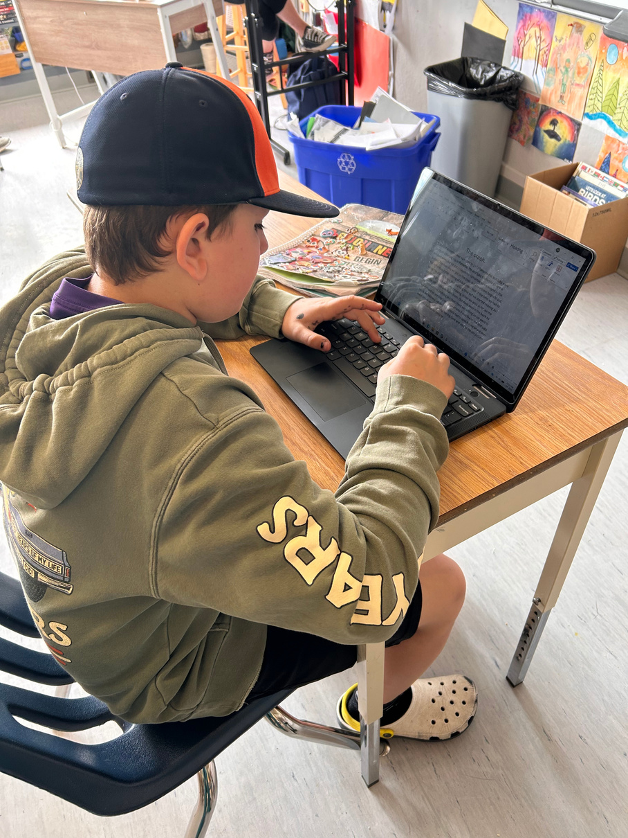
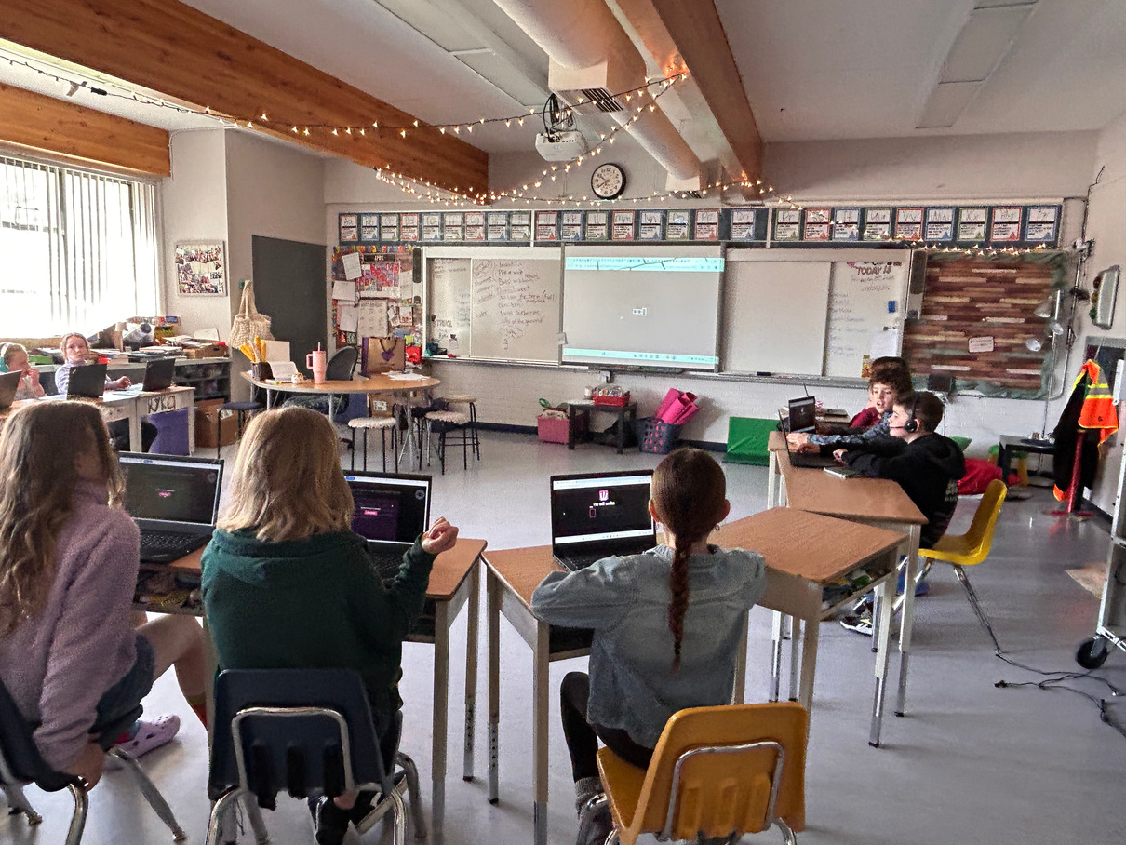
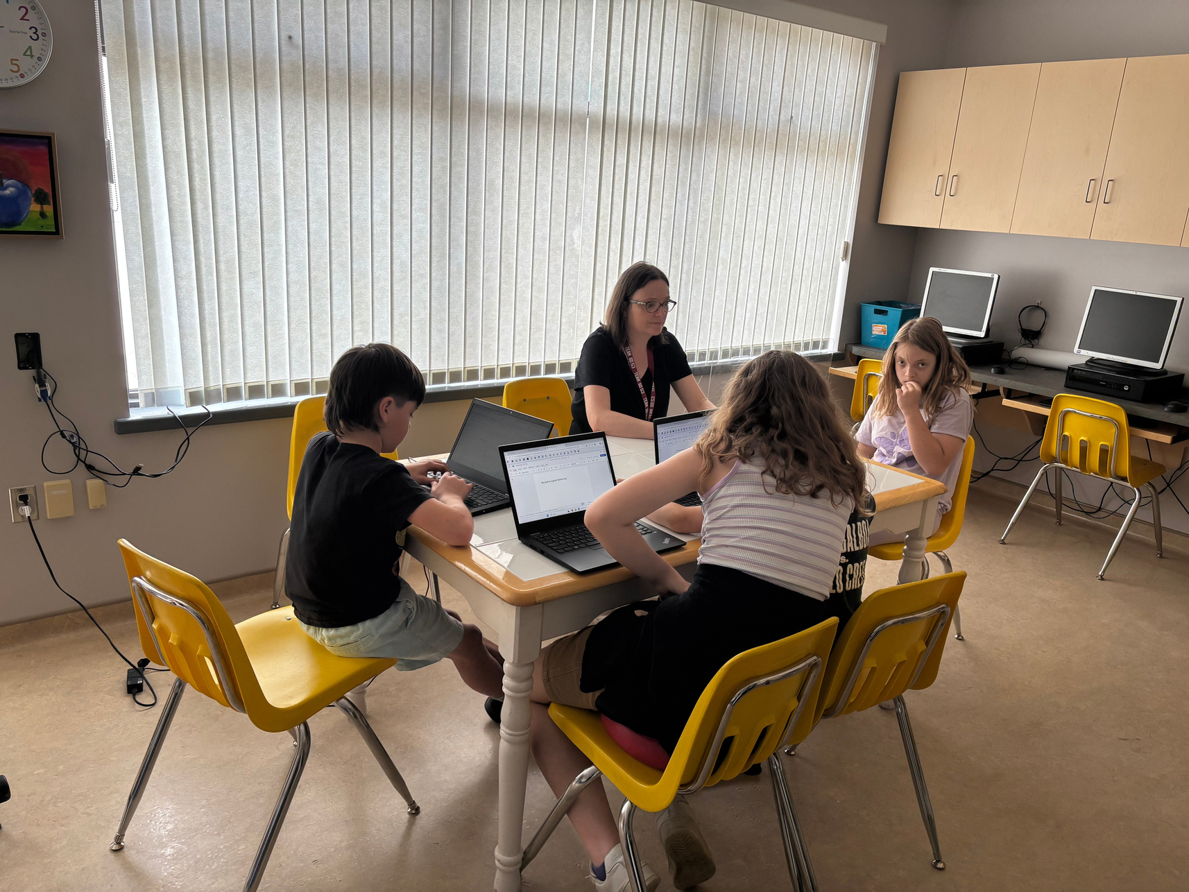
Assistive and universal technology are tools we are using increase the quality and stamina of writing for students.

Slide 8

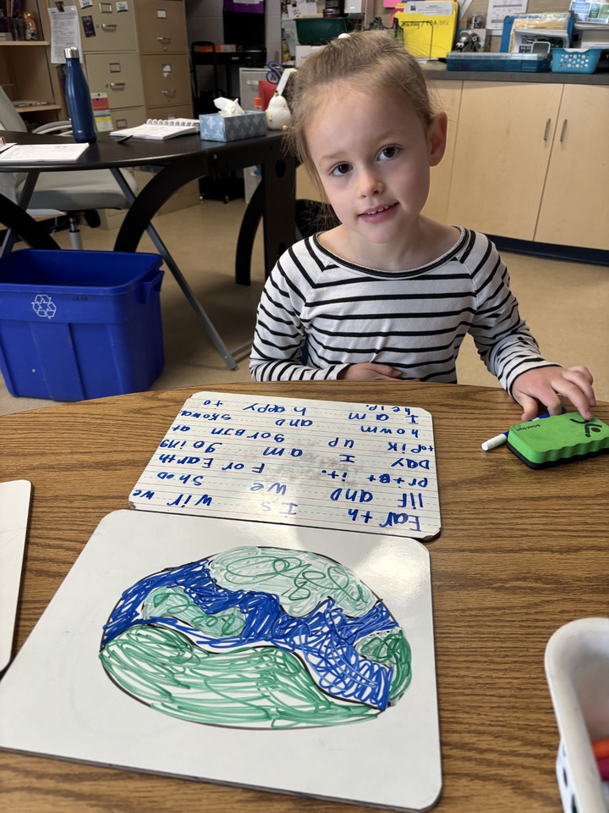
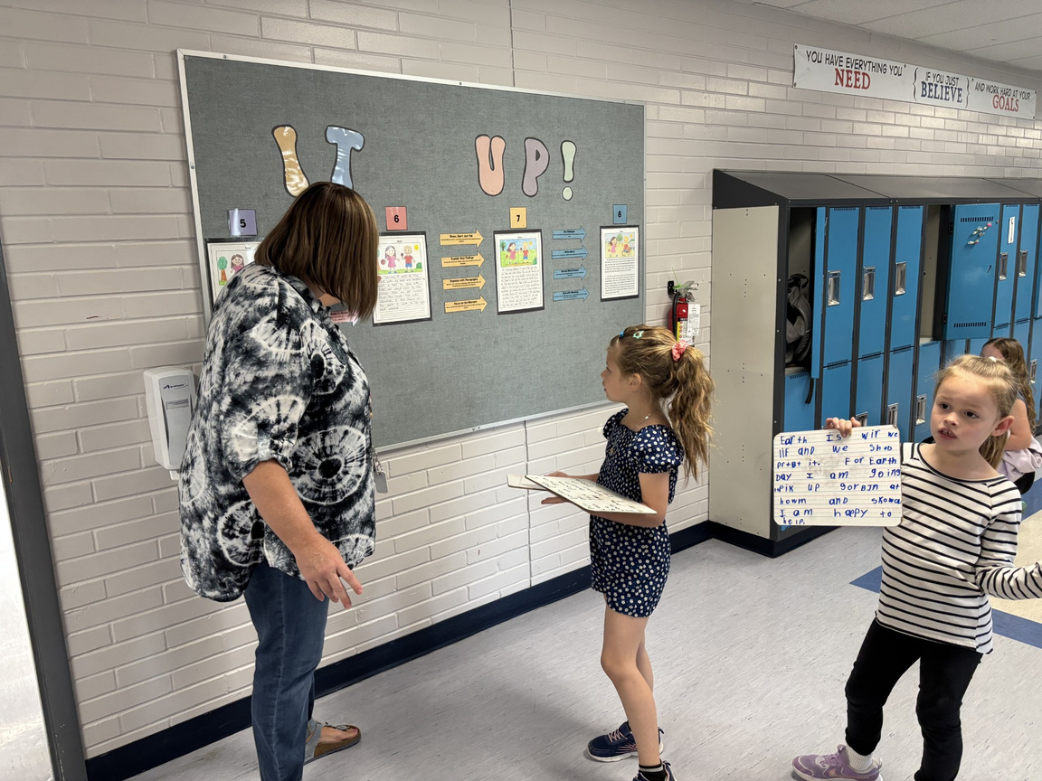
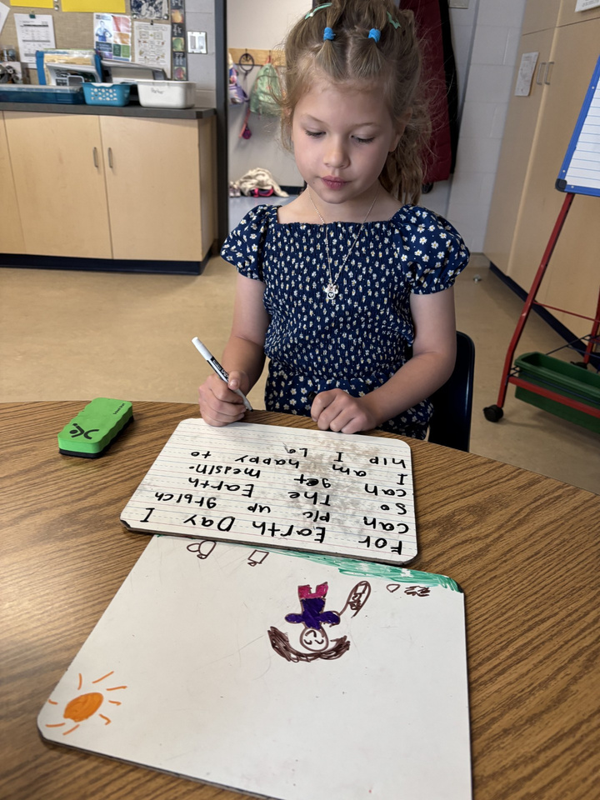

Bump it up

Slide 9
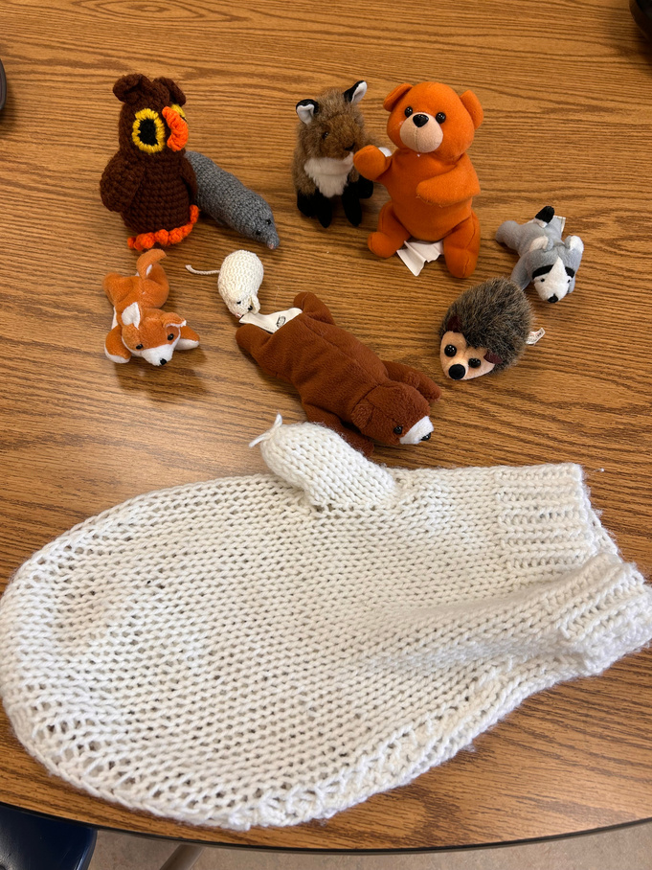
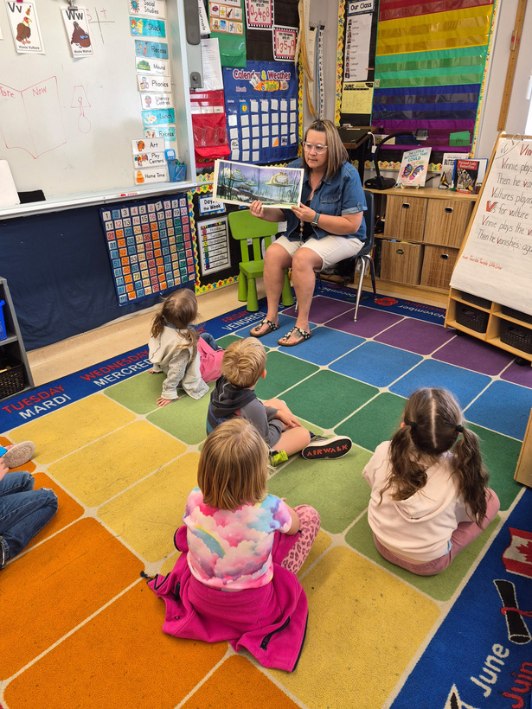
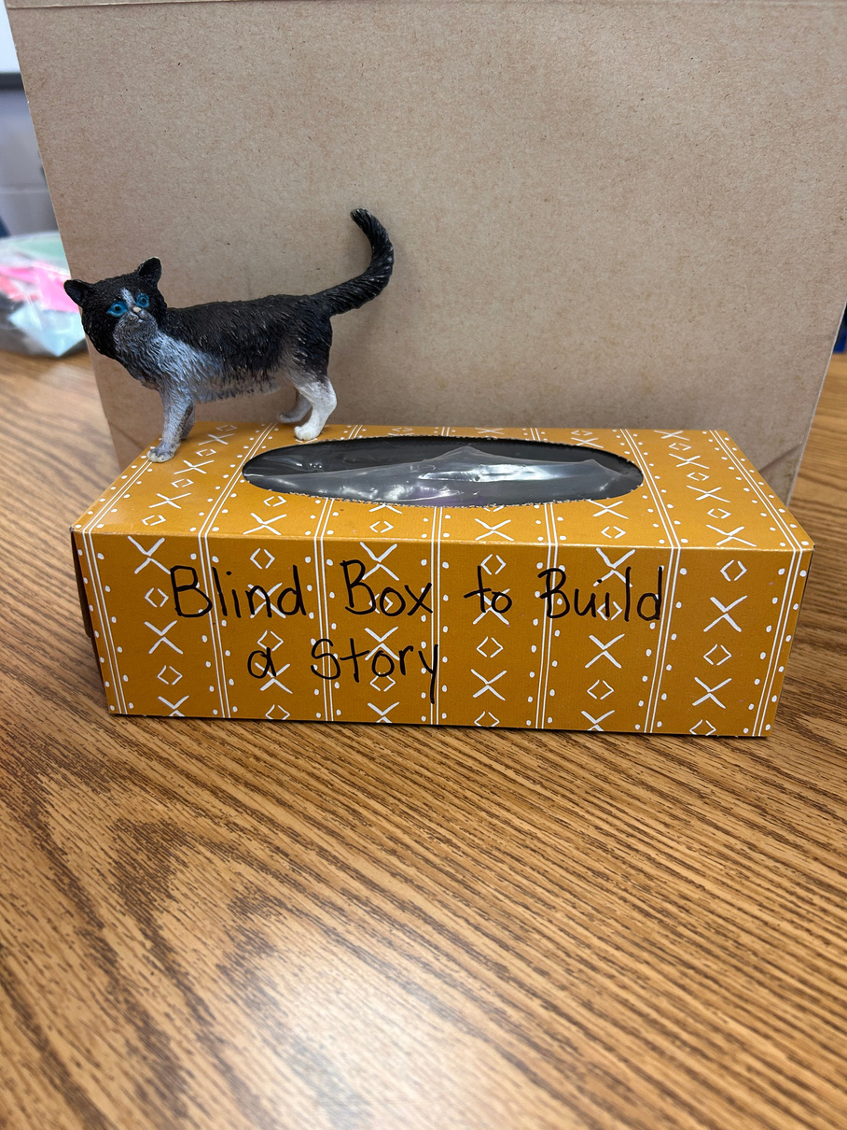
Supporting Oral story telling

Slide 10
school wide write
The whole school participated in a writing assessment that was used to not only assess where the students were at but also to give intentional feedback where needed. The school wide write was a great activity because it offered relevant topics that students identified in our scanning that could be helpful in the quality and stamina of their writing. We used the performance standards to assist as a rubric for this activity.

Slide 11


Checking
We used:
  Empathy interviews with students
  Staff check ins
  Writing samples
  FSA results
  Student report cards
  Informal checklists for oral skills
  Staff Observations
  Schoolwide writes (team marking)

Slide 12
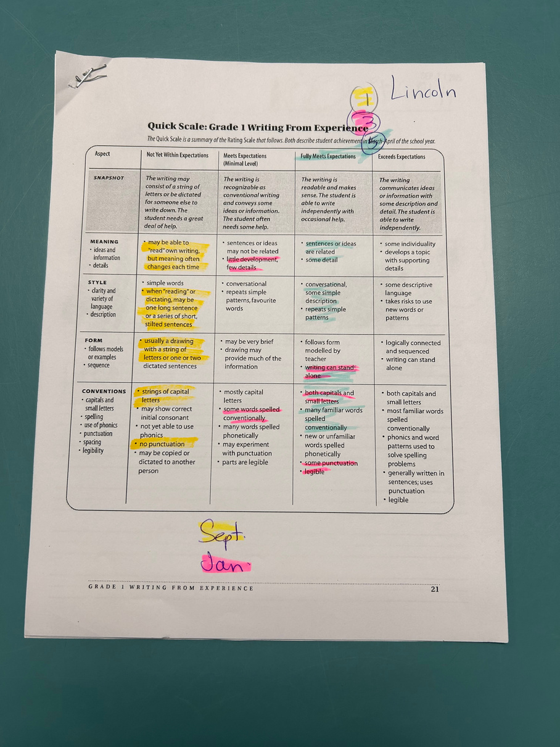
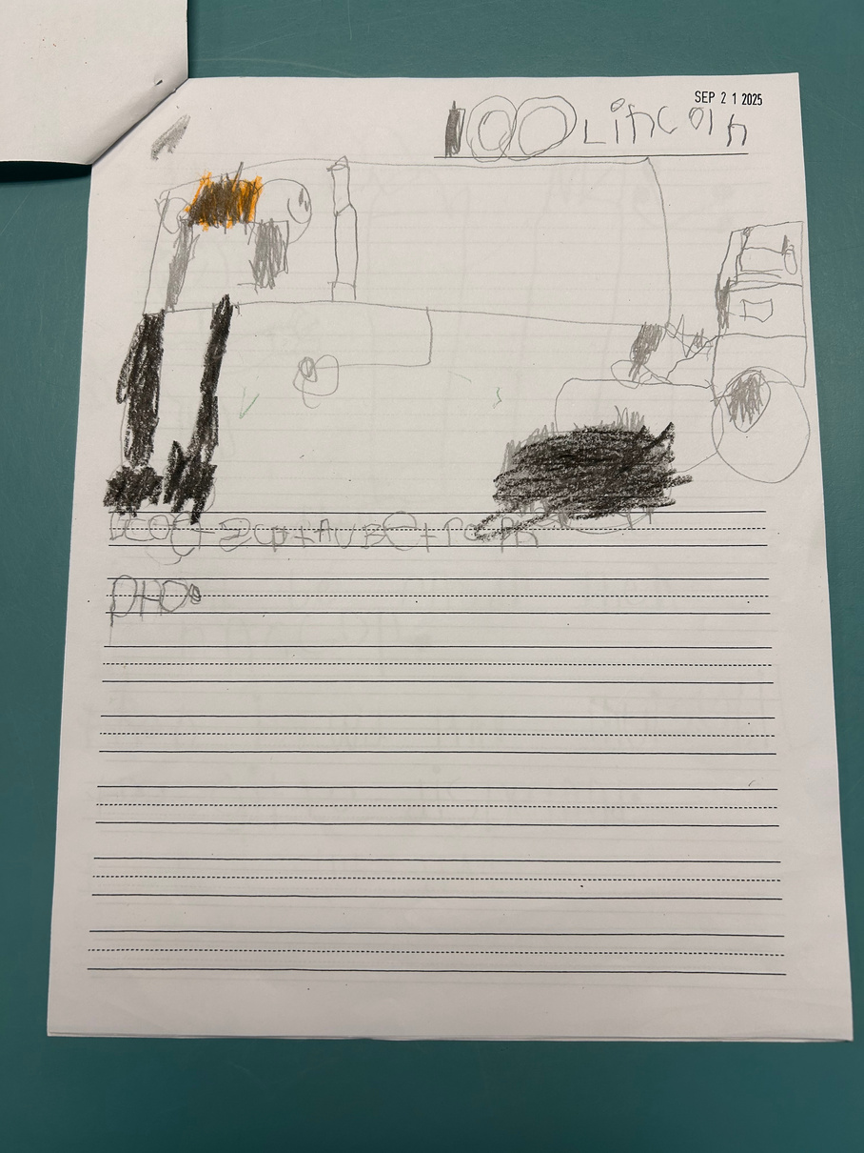
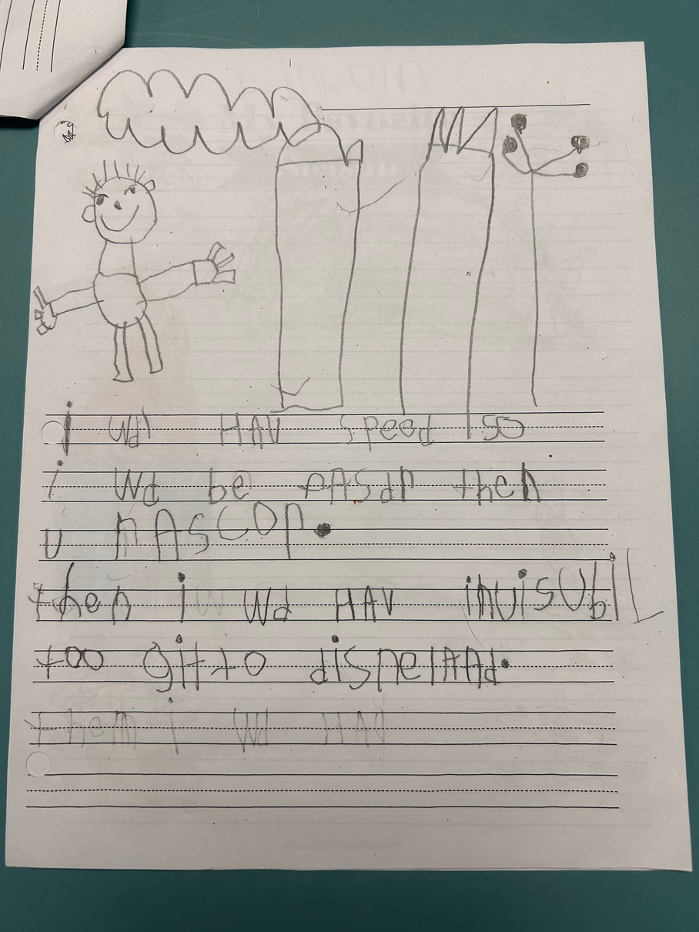
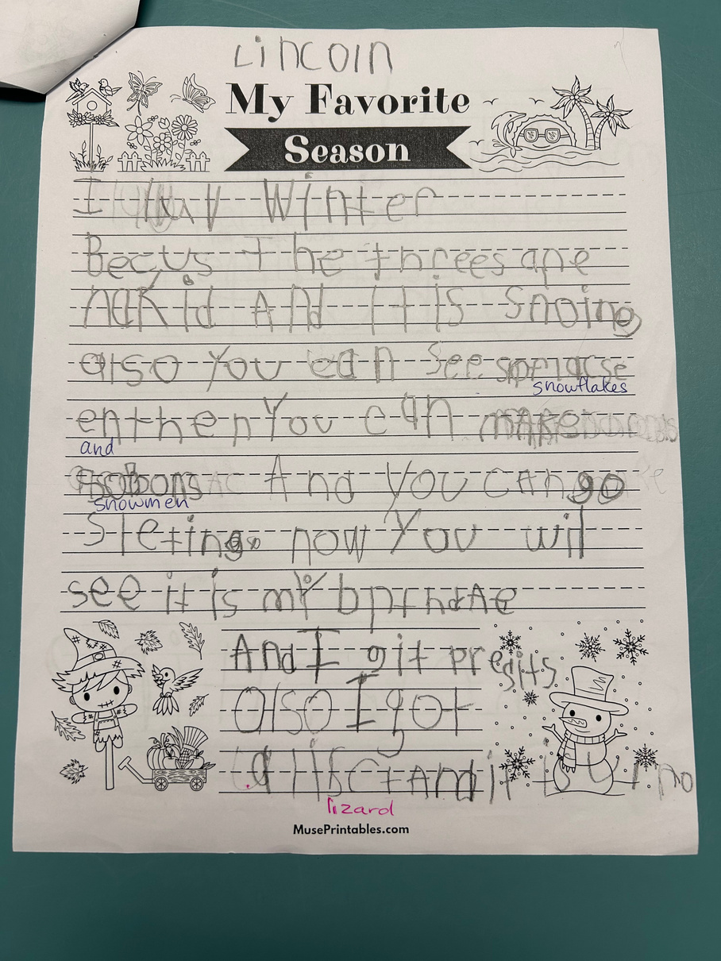
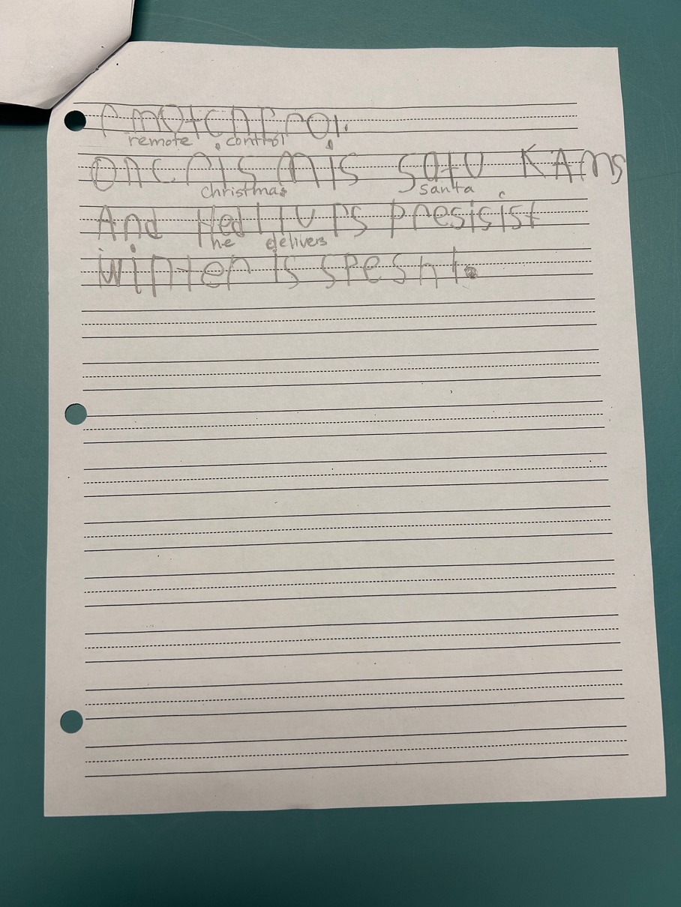

Slide 13
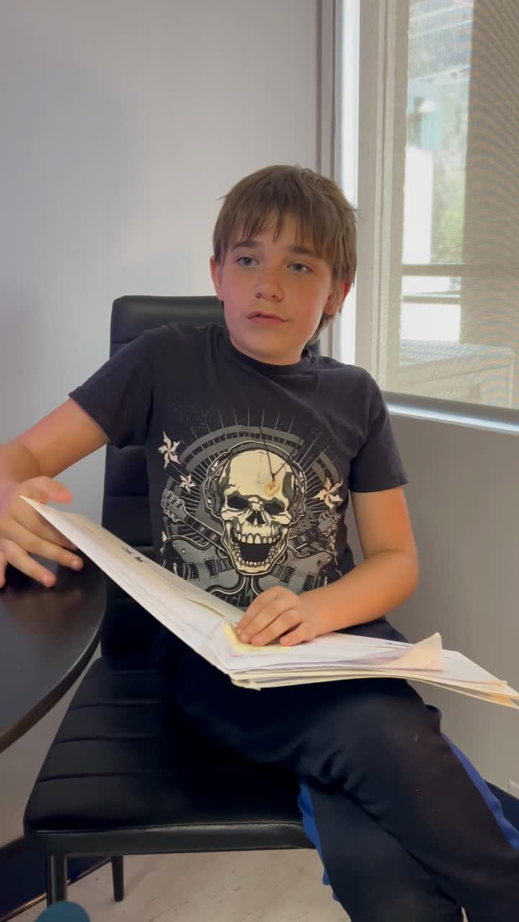
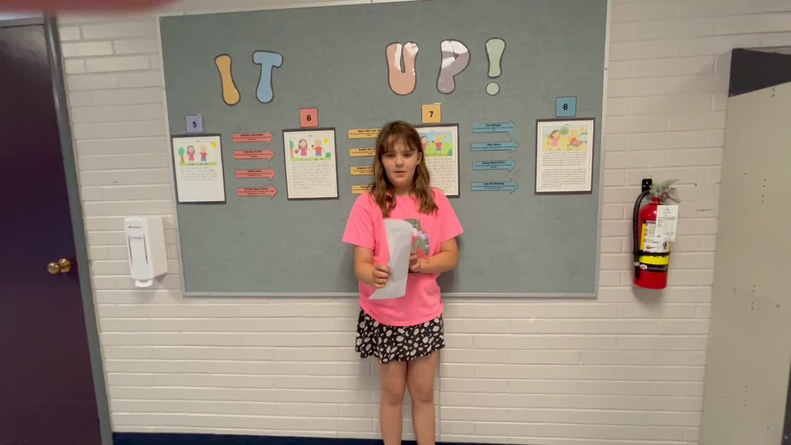
Street Data

Slide 14
  Student survey results
    Increase of 19% of students seeing themselves as writers.
    Increase of 20% of students having positive feelings about the writing process.
    Gained a deeper understanding of what students like to write about, what they find difficulty with and what they enjoy
    This shows a positive increase of self-reported competency in writing.
  School Wide Write Results
    Every division reduced the percentage of students in the lowest categories, with the strongest improvement at the k - 2 level.
    Increase of 34% of students that were proficient or extending from September to April
    Decrease of 30% at the emerging and low developing achievement level
    This shows a strong overall upward shift in writing achievement across the school year.
  FSA Results
    Increase 23% of grade 7 students are in the proficient range in literacy.
    Increase of 7% of grade 4 students are in the proficient range in literacy.
    This shows an overall increase of proficiency in literacy since last year.

Slide 15


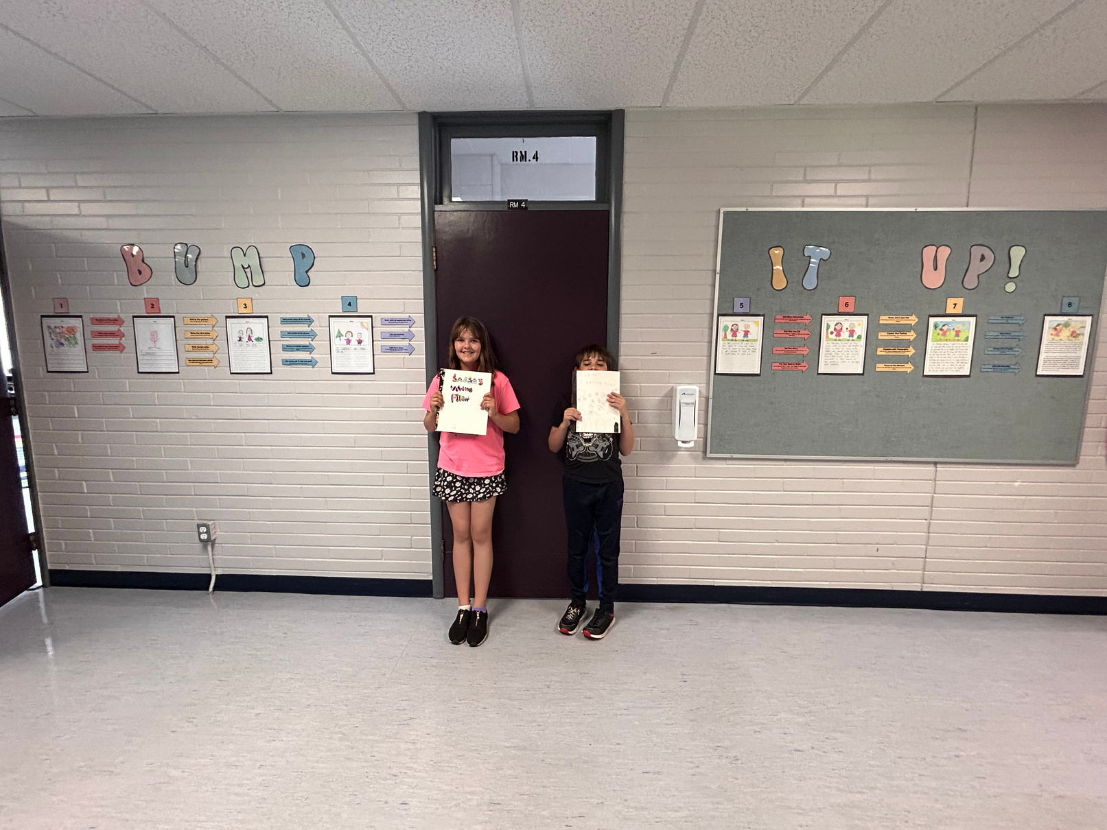
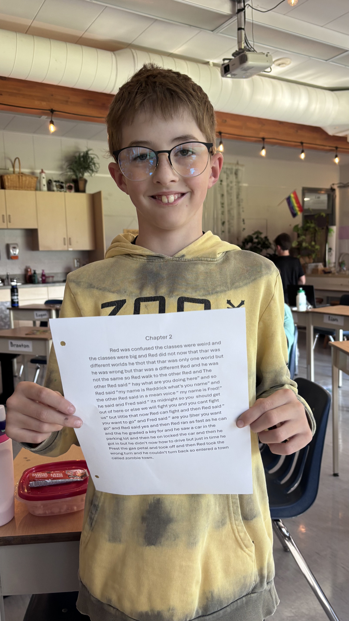


Slide 16
Have we made enough of a difference?
Empathy Interviews
  Upward trend on positive feelings about writing.
  Student report that they appreciate choice, relevant topics, and more time to plan and write.
  Spelling difficulties and noise make writing difficult.
  Making mistakes is hard
Teacher observations from writing samples
  Teachers have noticed an increase of writing quality
    Some reported that using an “author’s chair” increases quality
  They are beginning to see an increase in stamina; however not as much as they had hoped
    Some are using “writer’s workshop” and report that students will write for longer than the allotted time. Others are using smoking pencils and students like to challenge themselves to write more words than the last time.
  Some report more confidence in student writing
  Using an “author’s chair” increases quality
  Would like to include more oral language development - a goal for next year
Assessments
  Our literacy results have improved on the FSAs in both grades 4&7
  MDI results show a 6% decrease in academic self-concept
Yes, we would like to continue next year!

