Slide 1





OKANAGAN FALLS ELEMENTARY SCHOOL
SCHOOL PLAN
Enhancing Education and Student Success Through Writing; A multi-year plan.
2025/2026

Slide 2



Scanning
We used the following for our scanning this year and last year as well:
  FSAs
  Whole school year end data
  MDI
  School-wide write
  School-wide student survey
We have added the following to our scanning in the 2026-2027 academic year:
  Equity Scanning
    Compared writing grades of Indigenous students to non-Indigenous students
    Indigenous students participating in learning assistance vs. non-Indigenous students
    Compared participation of behavioural/emotional programming for Indigenous vs. non-Indigenous students

Slide 3
Scanning
Highlights from scanning:
  The oral language of many of our students is lacking
  Our Indigenous students are lower academically compared to non-Indigenous students
  We have 100% of our students in grade 6 that have a mid to high academic self-concept
  54% of our Indigenous students participate in learning assistance
  60% of our Indigenous students participate in emotional/behavioural programming with IST and/or CYCW
Data from September’s School Wide Write:

Slide 4
Scanning
Academic performance data indicate that the primary area of concern is the quality of student writing. Our analysis also showed that writing stamina is not currently a significant issue. As a result, we believe that focusing on improving the quality of student writing remains the area where we can have the greatest impact on student achievement. We have already made meaningful progress in this area, and we are confident that continuing this work will lead to further improvements in student outcomes. The evidence also shows us that students have a varying degree of environmental and functional experiences. This leads us to wonder if shared experiences might improve the quality of student writing as they draw upon these experiences.

Slide 5






focusing
Keeping in line with our district’s strategic plan and using the student achievement pillar, our aim is to continue to develop whole-school methods to improve the quality of student writing through thoughtful, purposeful and consistent instructional approaches.

Slide 6





Developing a hunch
How might our use of technology and other evidence-informed strategies play a role in the lack of quality and stamina in student writing?
Are we providing enough purposeful feedback and how could a lack of feedback play a role?
Are our instructional practices and language are consistent enough across classrooms and grade levels for students to recognize and apply them when they move to a different teacher or the next grade?
To what extent might our use of oral language strategies be
influencing student writing outcomes?
Are we being intentional in giving equal access to all students to shared experiences?

Slide 7




Learning
  Adrienne Gear
  Occupational Therapy training
  Clothes Lines and/or Performance Standards
  Look to find brain-based assessments that break down where students might be bottoming out.
  To seek out books and resources on writing prompts (engaging topics to improve stamina)
  Printing Like a Pro and other Sunnyhill Resources
  Bump It Up Program
  Read and Write program
  How do students feel about themselves as writers and what do they feel like they need to be successful
  Gathering resources from the community about what shared experiences we can add to our practices
  Re-designing the rubrics that we are using to align with the learning progressions
  More learning around the proficency scale
  Digging into the First Peoples Principles of Learning

Slide 8




taking action
What strategies will we implement? (focus on Mastery and Independence)
  To create writing resource folders for each classroom
  Creating fun and engaging opportunities that support stamina in writing
  Bump It Up Program
  Giving choice for writing topics
  Consistent and specific feedback (sticky notes, Spaces comments, peer editing, Bump It Up)
  Find ways to support oral story development in the classroom
  Creating a list of strategies for writing that support staff can refer to when asked to support writing
  Provide intensional shared learning experiences to our writing strategies

Slide 9
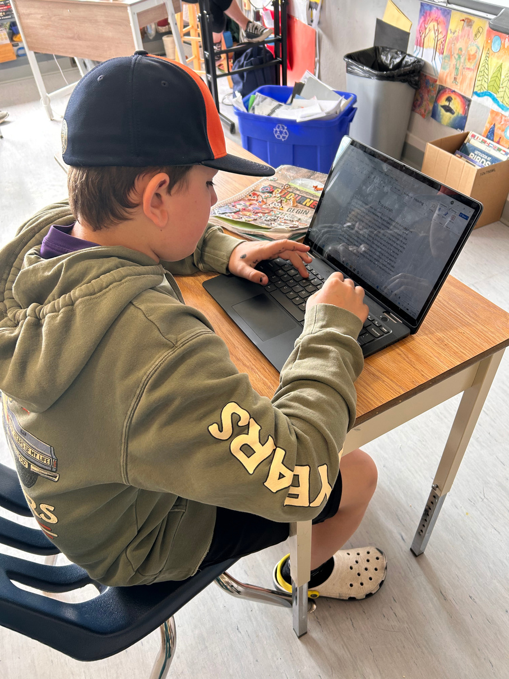
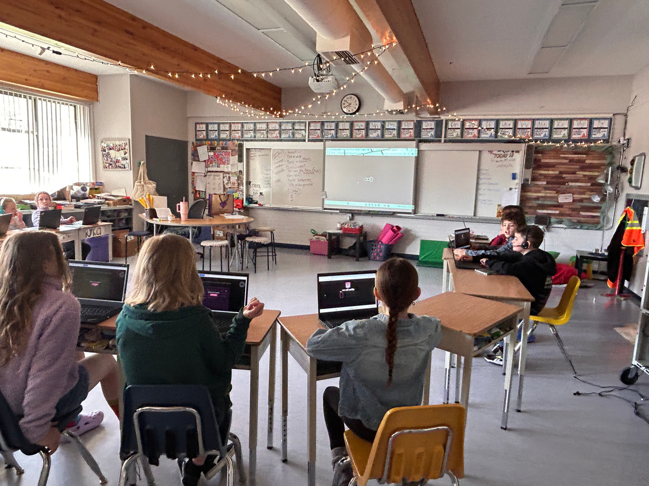
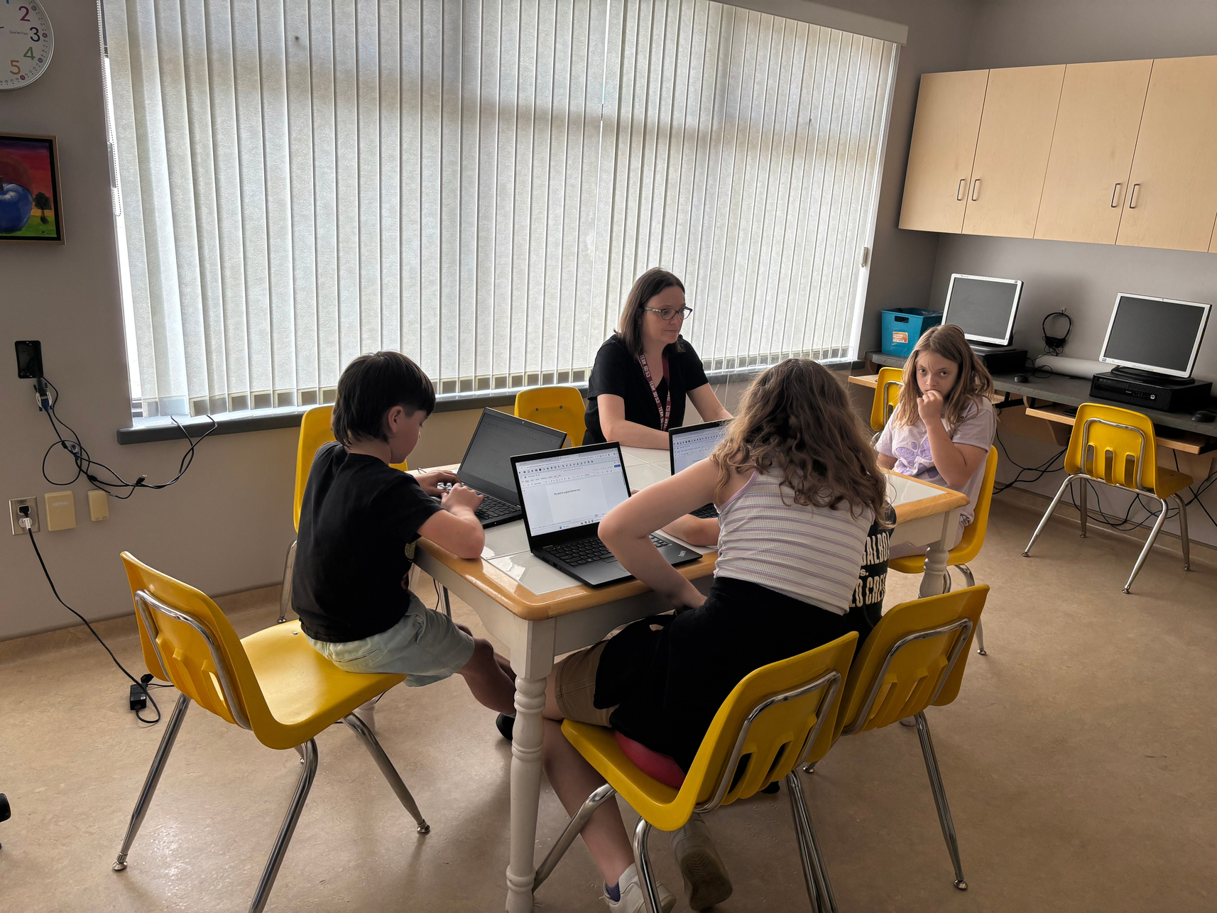
Assistive and universal technology are tools we are using increase the quality and stamina of writing for students.

Slide 10

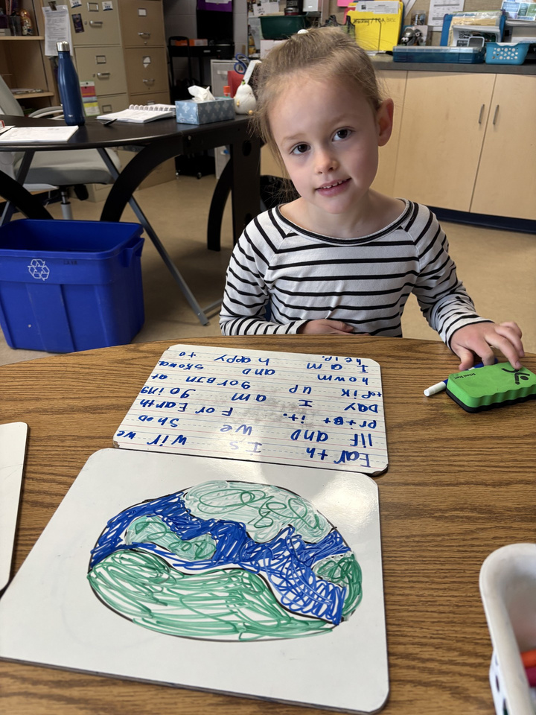
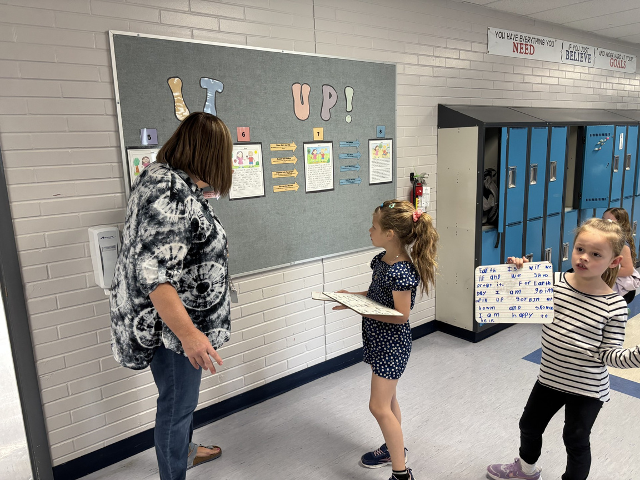
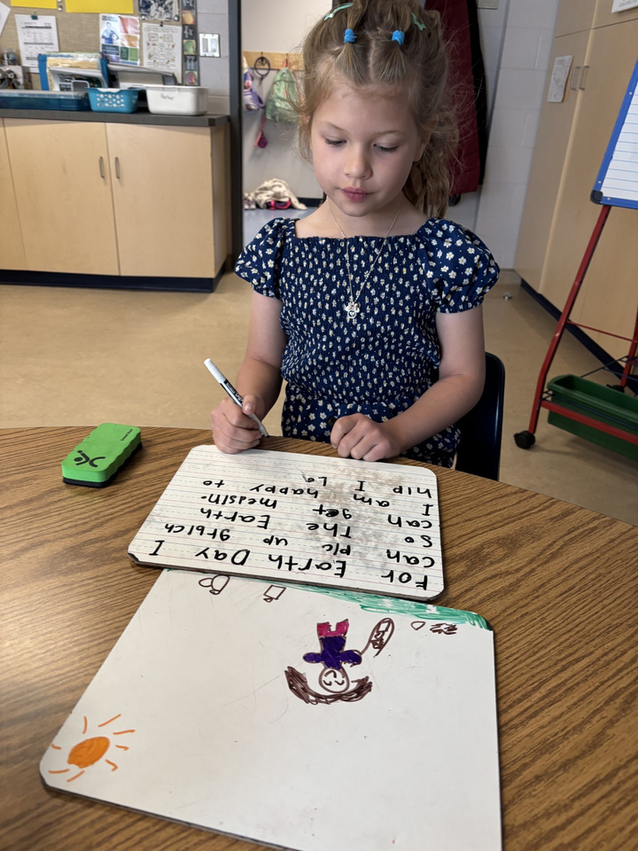

Bump it up

Slide 11
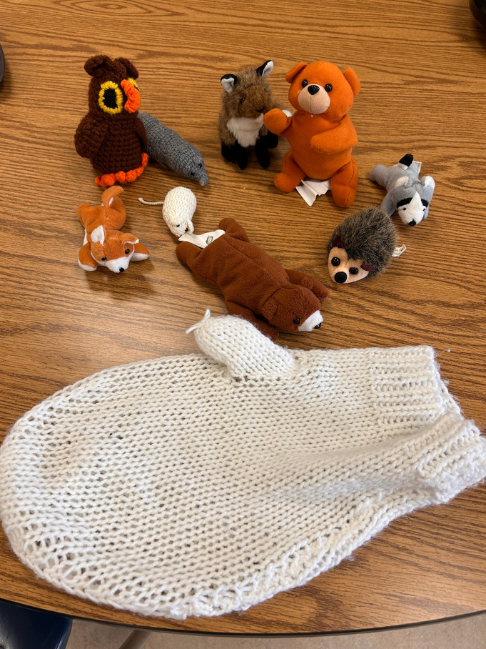
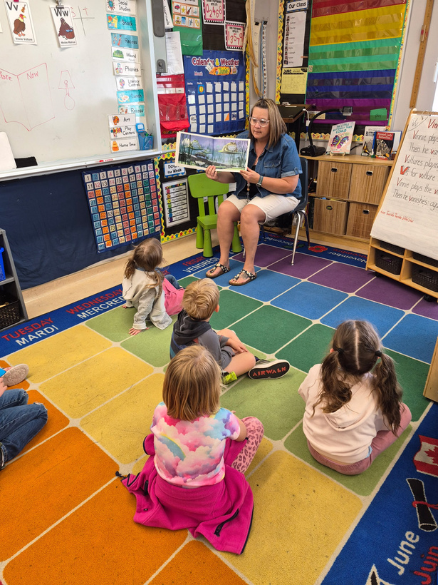
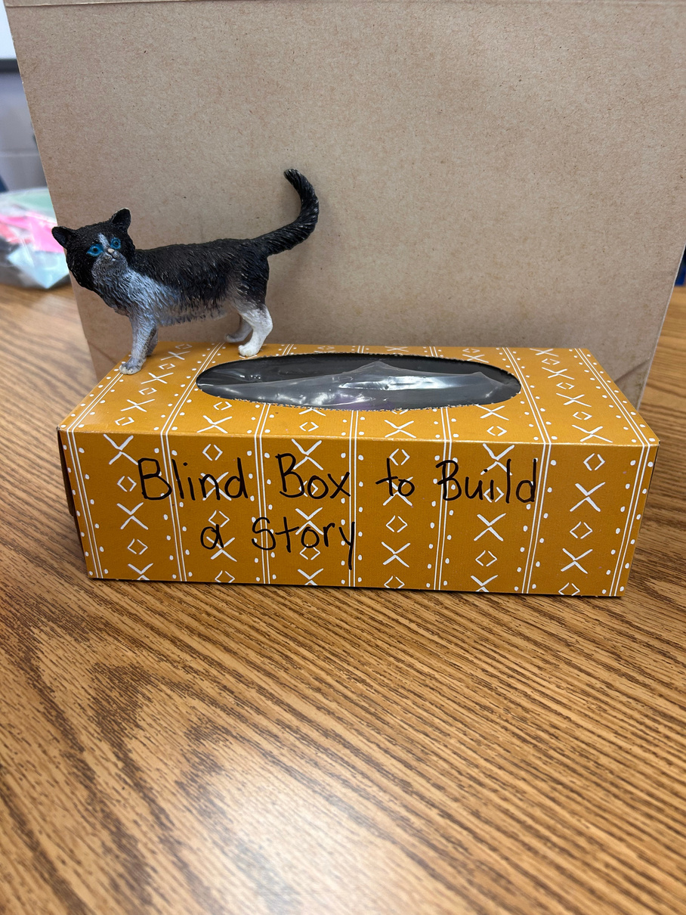
Supporting Oral story telling

Slide 12

school wide write
The whole school participated in a writing assessment that was used to not only assess where the students were at but also to give intentional feedback where needed. The school wide write was a great activity because it offered relevant topics that students identified in our scanning that could be helpful in the quality and stamina of their writing. We used the performance standards to assist as a rubric for this activity.

Slide 13


Checking
We used:
  Empathy interviews with students
  Staff check ins
  Writing samples
  FSA results
  Student report cards
  Informal checklists for oral skills
  Staff Observations
  Schoolwide writes (team marking)

Slide 14
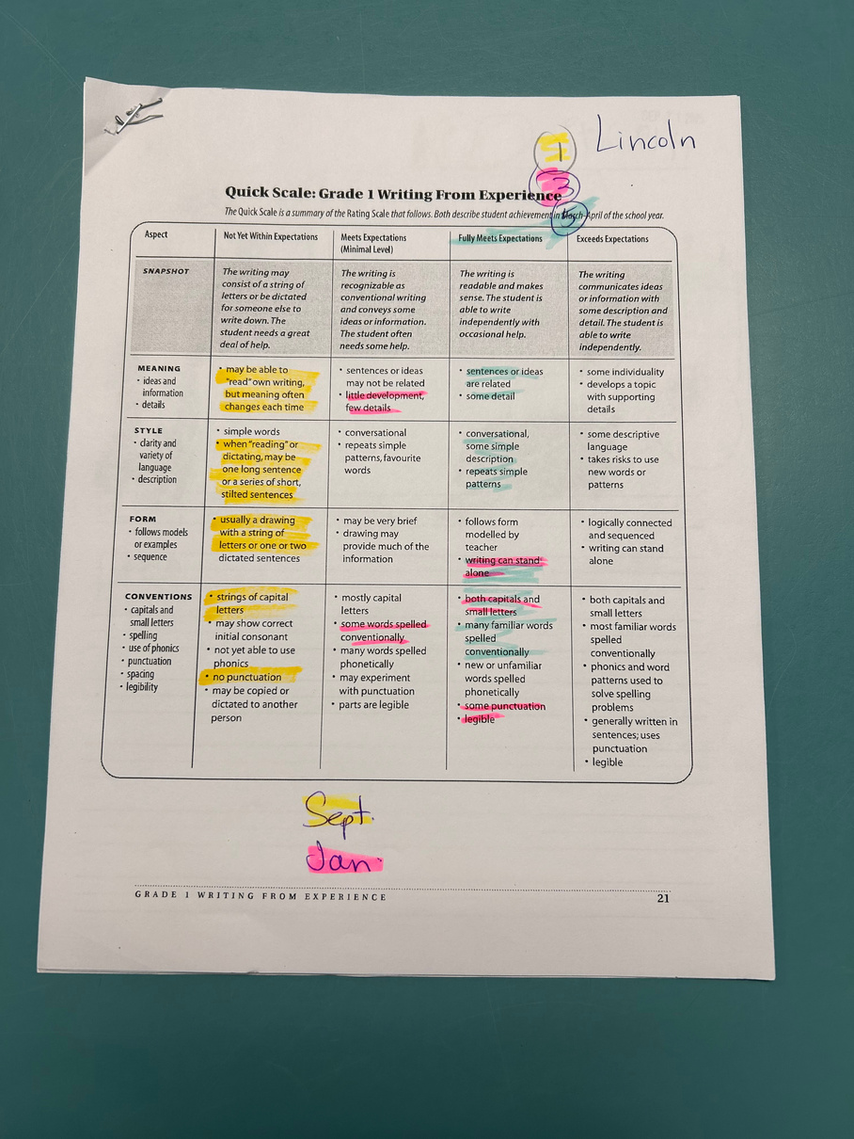
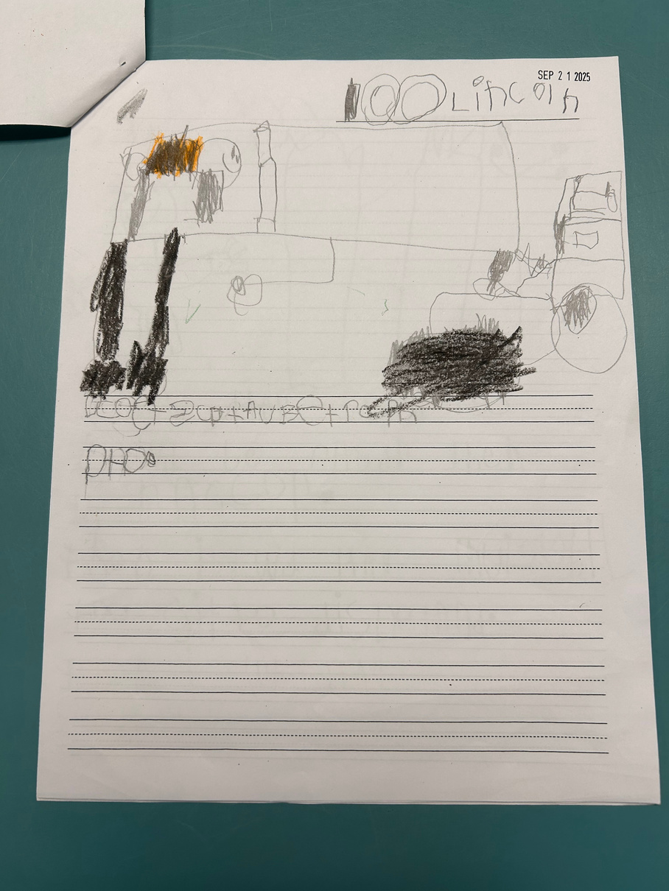
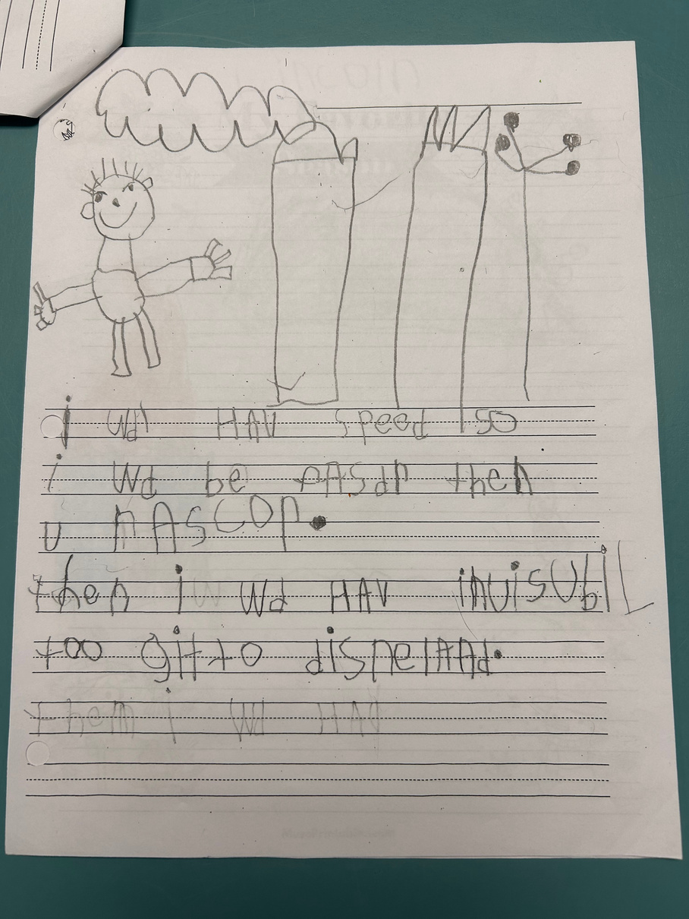
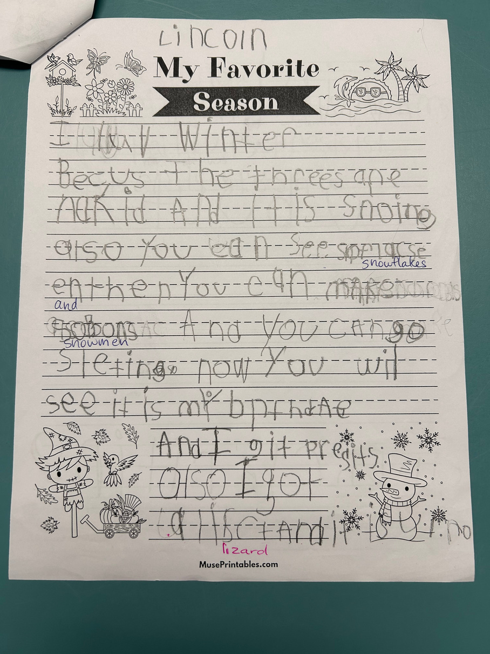
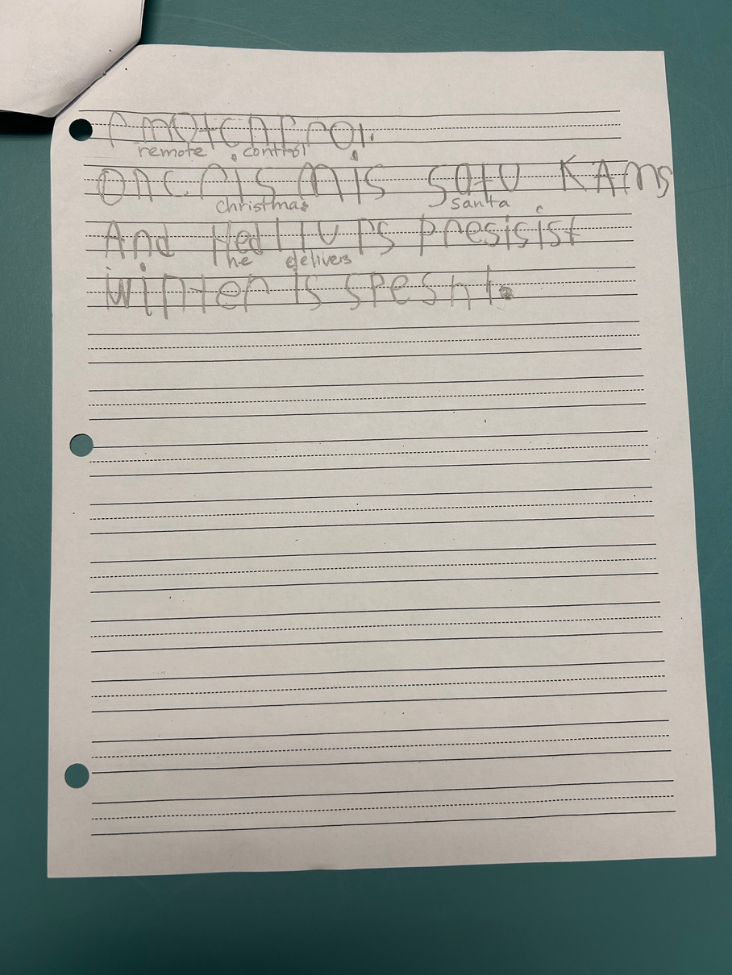

Slide 15
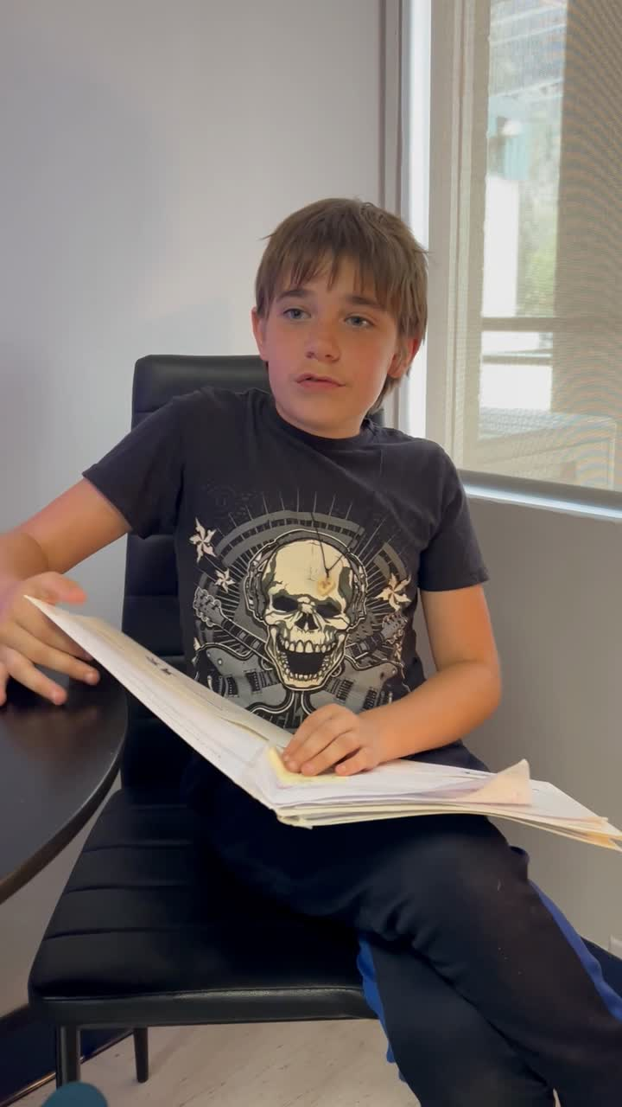
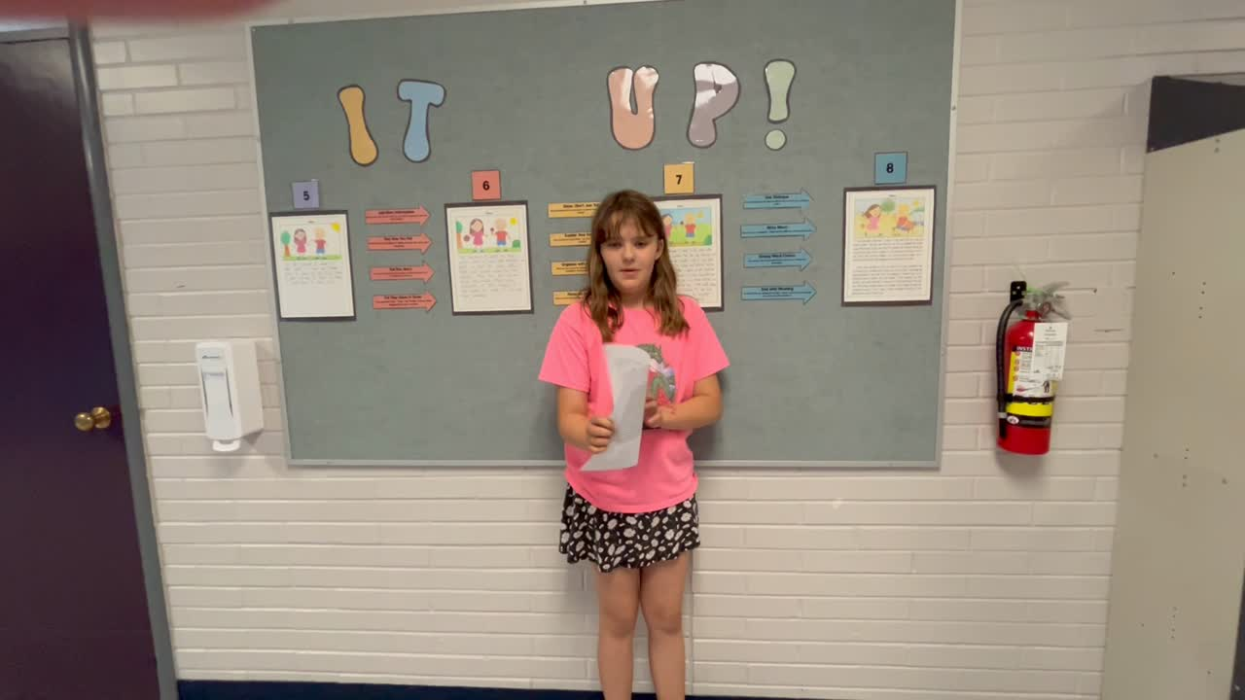
Street Data

Slide 16


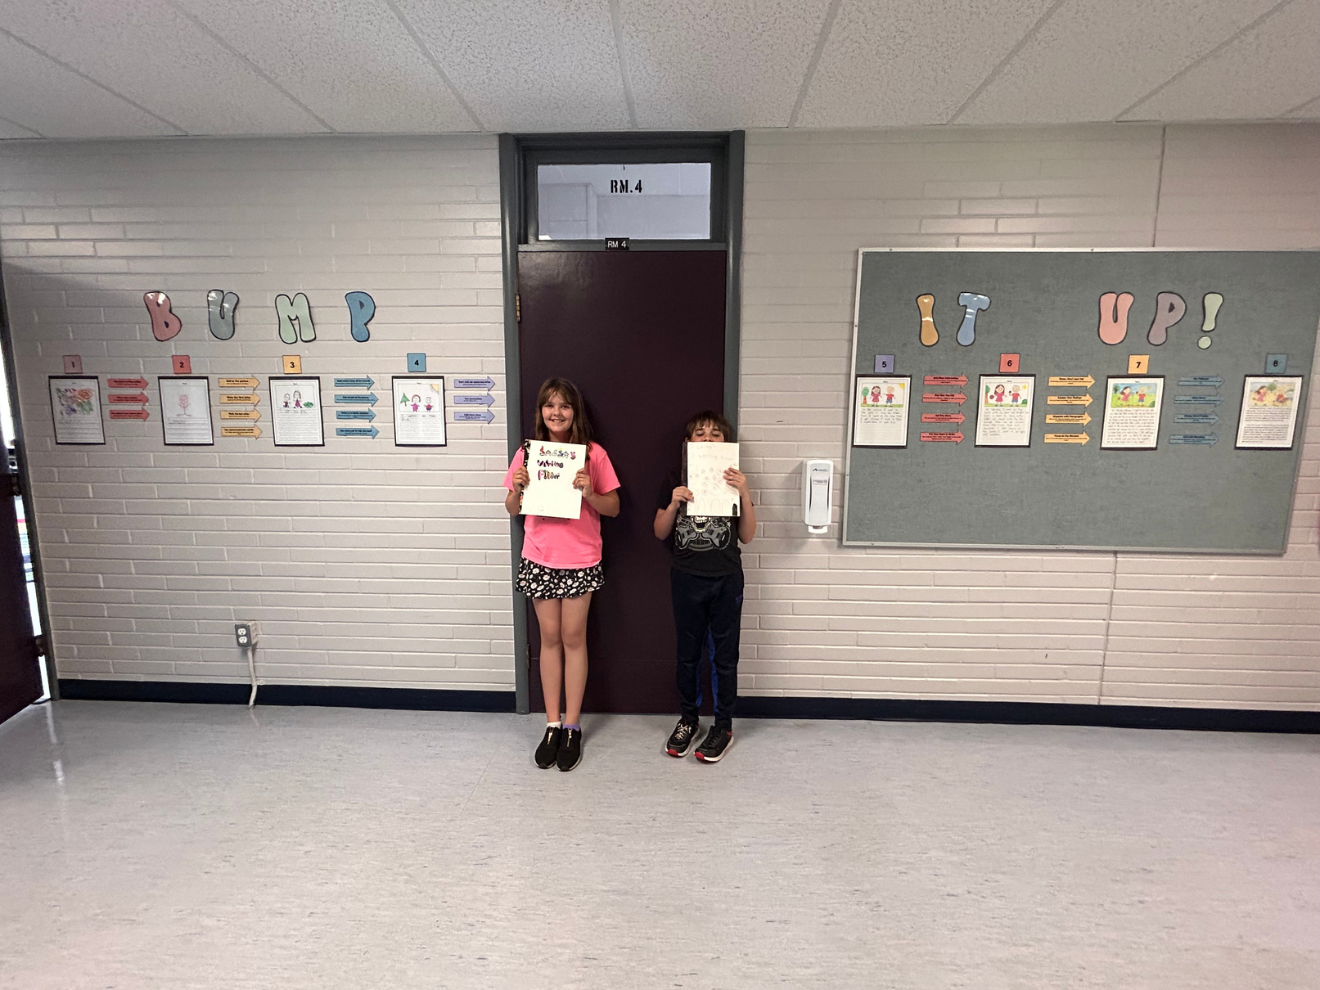
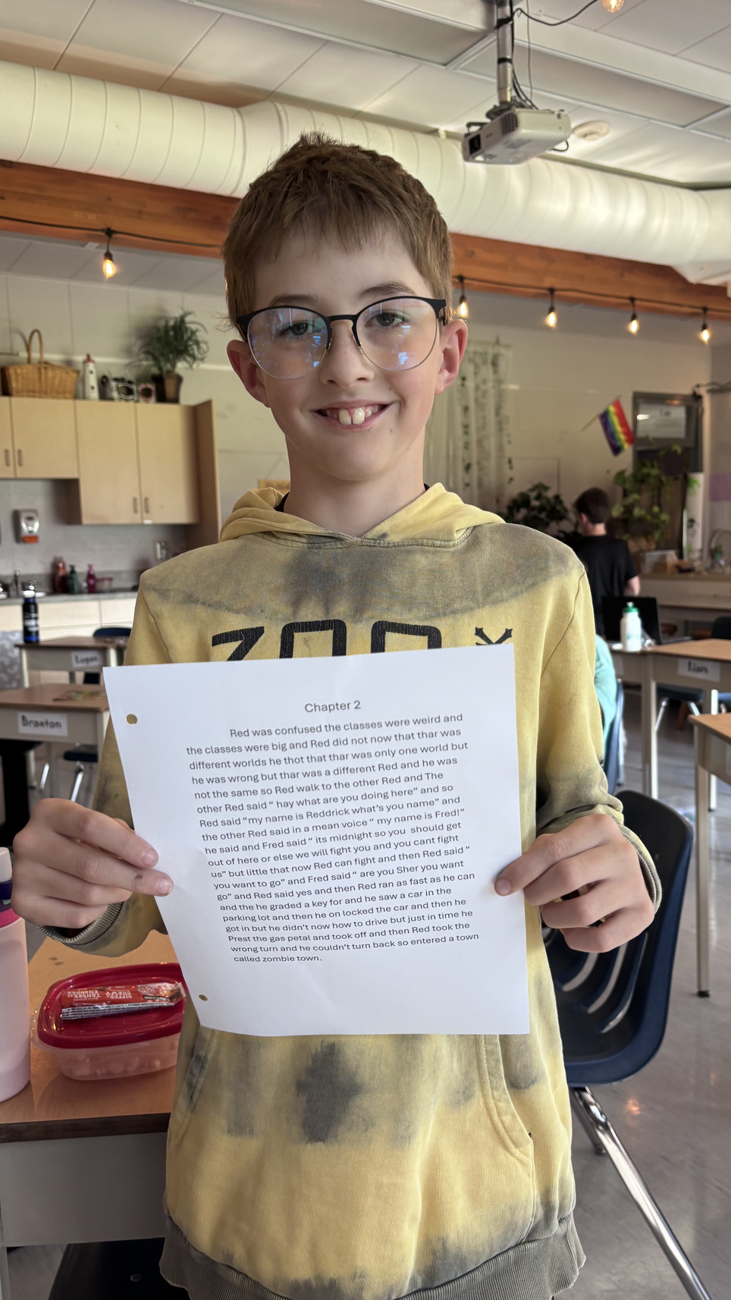


Slide 17
We can’t wait to see the growth this year!
More to come!!

